Slide 1
Muesli Delivery
EDA
Cayenne Clusters Muesli Project Presentation
Erick + Antonio + Dasha
March 16, 2026

Slide 2
Agenda
01
Data: Overview & Cleaning
02
Delivery Process: Flow & Steps
03
Our Approach
04
Main KPIs Explained
05
Diagnostic analytics
06
Conclusions & Recommendations

Slide 3
01 Data Overview and Cleaning
Orders
Interns
Process
Campaign
Total records: 5009
Unique orders: 5009
Main info:
order_date
ship_mode
origin_channel
Total records: 204
Unique orders: 204
Main info:
ready_to_ship_date
pickup_date
Total records: 3002
Unique orders: 3002
Main info:
on_truck_scan_date
truck_ship_mode
Total records: 333
Unique orders: 333
Main info:
arrival_scan-date

Slide 4
01 Data Overview & Cleaning
Key Takeaways:
The project uses several datasets: orders, intern warehouse observations, shipment scans, and customer arrival scans
The data was cleaned to make sure column names and date formats were consistent
Data columns were converted so we could calculate time differences between delivery stages
After cleaning, the datasets were merged to reconstruct the full delivery process for each order

Slide 5
02 Delivery Process: Flow & Steps
Data Sources
Orders
order_date
ship_mode
Intern Warehouse Observations
ready_to_ship_date
pick_up_date
Shipment Scan Data
on_truck_scan_date
truck_ship_mode
Customer Arrival
Scan Data
arrival_scan_date
Order
Warehouse Processing
Truck Picks Up
Transportation
Arrival
Customer places an order
Order is recorded in the system
Order is processed in the warehouse
Processing time: ~2 days
Logistics company picks up the order
Trucks leave: Monday, Wednesday, Friday
The order is transported to the customer
Average delivery time: ~3 days
Customer receives the order
Arrival scan recorded via QR code

Slide 6
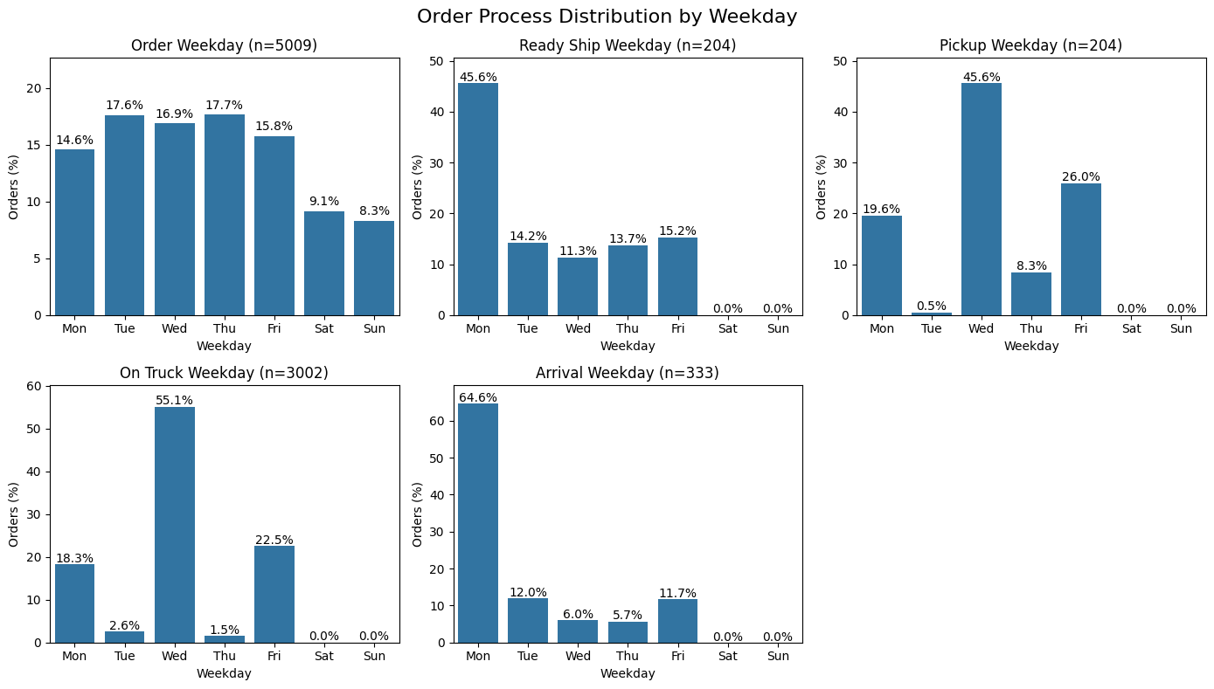
Order >>> Warehouse >>> PickUp >>>

Slide 7
You Order Is on the Way >>> Delivery!

Slide 8
Our Approach:
Calendar Days vs.
Business Days
In our group we used both approaches to calculating the main metrics:
Calendar Days | Business Days
"Pessimistic" Assumption | "Optimistic" Assumption
clients make orders all week | warehouse doesn't work on weekends; trucks pick up orders on Mon, Wed, Fri only

Slide 9
04 Main KPIs Explained
Stages | From | To | Data Available
Warehouse Processing | Order date | Ready to ship day | Partial (intern data)
Waiting for Truck | Ready to ship date | On truck scan date | Partial (intern data)
Full Warehouse time | Order date | On truck scan date | Partial (truck company data)
Delivery | On truck scan date | Arrival scan date | Partial (truck company data + campaign data)
Total Delivery Time | Order Date | Arrival Scan Date | Partial (campaign data)

Slide 10
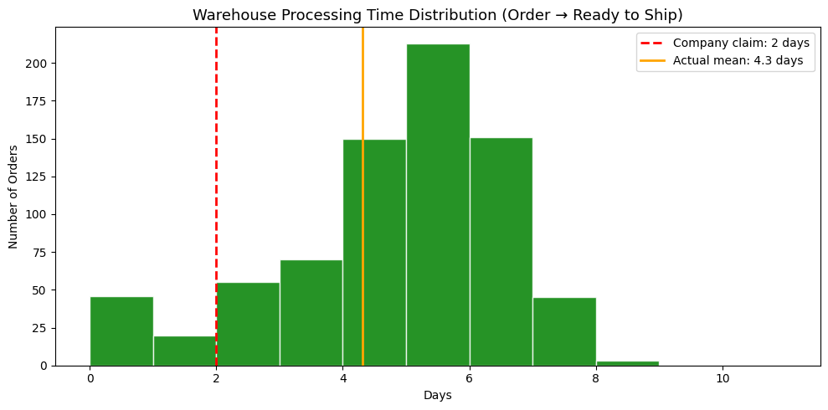
04 Warehouse Processing Time
Ready to ship date (Intern data) - Order date (Order process data)
Scenario 1
(with duplicates, calendar days):
* n = 753
* mean = 4.3 days
* median = 5 days
* max = 8 days
Company claims~2 days

Slide 11
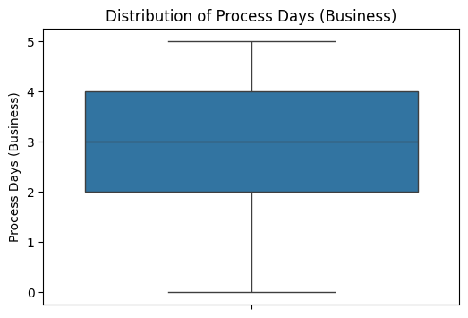
04 Warehouse Processing Time
Scenario 2 (business days)
Warehouse claims that the processing of each order takes on average 2 days.
Business Days Stats:
mean 2.769608
std 1.417991
min 0.000000
25% 2.000000
50% 3.000000
75% 4.000000
max 5.000000
Ready to ship date - Order date
n = 204
Notes:
Even the optimistic scenario (business days only) does not support the warehouse claim about 2 processing days.

Slide 12
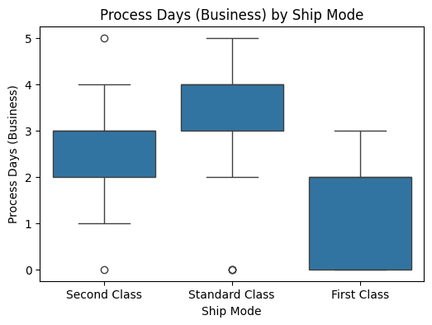
04 Warehouse Processing Time by shipment mode
Business Days Stats:
(for the entire sample)
mean 2.769608
std 1.417991
min 0.000000
25% 2.000000
50% 3.000000
75% 4.000000
max 5.000000
Ready to ship date - Order date
n = 204
Notes:
Even the optimistic scenario (business days only) does not support the warehouse claim about 2 processing days.

Slide 13
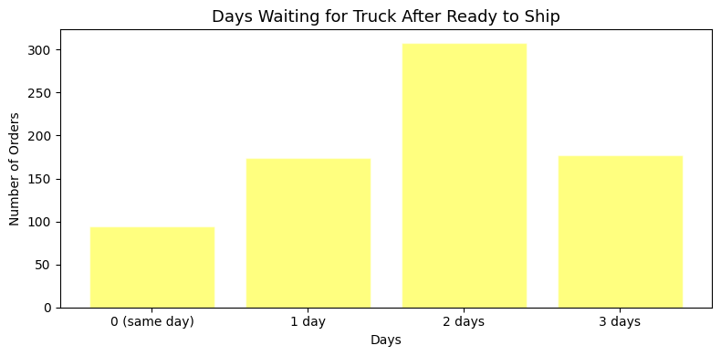
04 Waiting for Truck
Pick up date (Intern data) - Ready to ship date (Intern data)
Scenario 1
(with duplicates, calendar days):
* n = 753
* mean = 1.75 days
* median = 2 days
* max = 3 days
Company claims = 1 day
Same days pickups = 12.5%

Slide 14
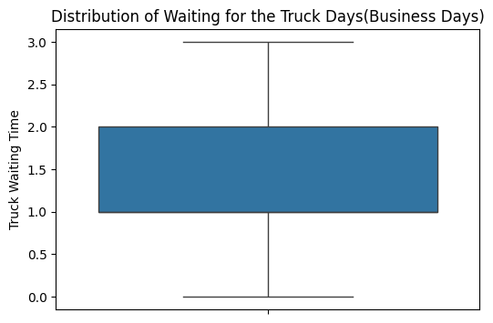
04 Waiting for Truck Time
Scenario 2: No duplicates, business days
Truck company claims that the truck pick up timeline is one day on average
Business Days Stats:
mean 1.357843
std 0.821141
min 0.000000
25% 1.000000
50% 1.000000
75% 2.000000
max 3.000000
Pick_up_date - ready_to_ship_date
n = 204

Slide 15
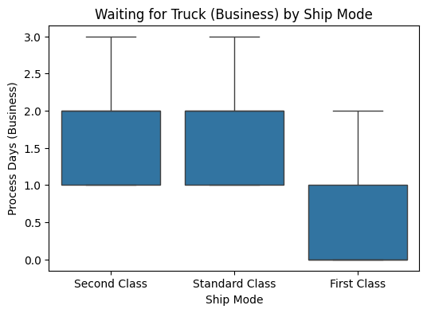
04 Waiting for Truck Time
by shipment mode
Scenario 2:
No duplicates, business days
Truck company claims that the truck pick up timeline is one day on average.
Pick_up_date - ready_to_ship_date
n = 204

Slide 16
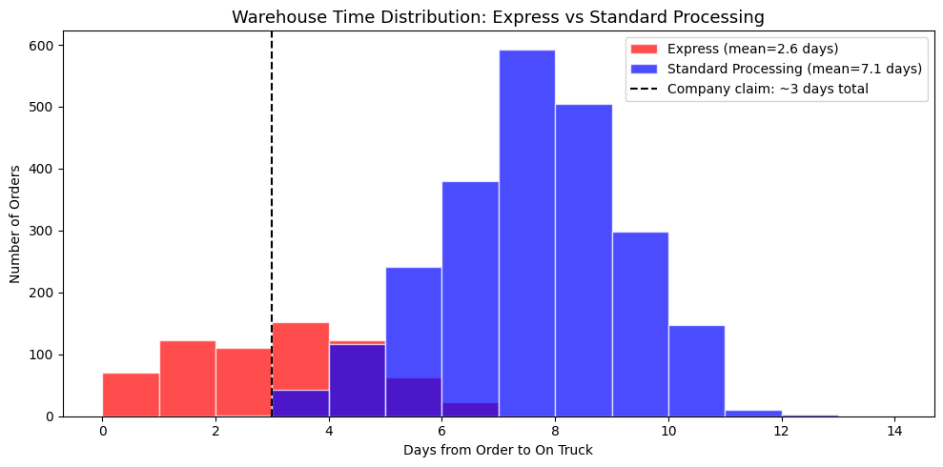
04 Full Warehouse Time
On truck scan date (Order process data) - Order date (Order process data)
Scenario 1
(with duplicates, calendar days):
* n = 5899
* mean = 6.1 days
* median = 7 days
* max = 12 days
Company claims = 3-4 days
Express mean = 2.6 days
Standard processing mean = 7.1 days

Slide 17
04 Full Warehouse Time:
warehouse vs. truck company
We can compare the small data from warehouse (interns) to the big data (from the truck company)
Good
Bad
Two datasets match >>> we can trust the assumption about the average amount of days for warehouse processing
It's higher than the promise from the warehouse
Warehouse Data:
count 204.000000
mean 4.127451
std 1.839209
min 0.000000
25% 3.000000
50% 5.000000
75% 5.000000
max 7.000000
Truck Company :
count 3002.000000
mean 4.331779
std 1.847353
min 0.000000
25% 3.000000
50% 5.000000
75% 6.000000
max 9.000000
[Pick_up_date - order_date],
Business days
[On_truc_scan_date - order_date],
Business days

Slide 18
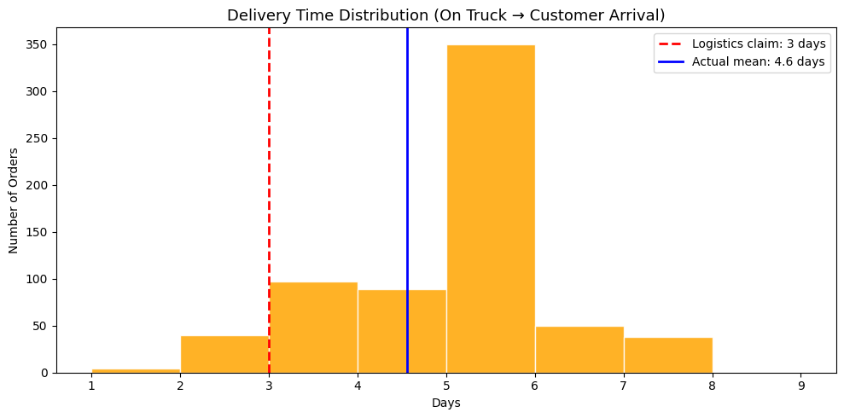
04 Delivery (Transportation) Time
Arrival scan date (Campaign data) - On truck scan date (Order process data)
Scenario 1
(with duplicates, calendar days):
* n= 668
* mean= 4.6 days
* median= 5 days
* max= 7 days
Company claims= 3 days

Slide 19
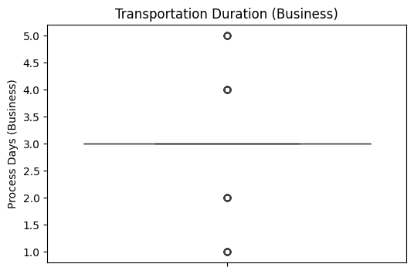
04 Delivery (Transportation) time
Arrival_scan - On_truck_scan
n = 333
Scenario 2: No duplicates, business days
Truck company claims that the truck pick up timeline is three days on average.
Haha. Some pretty confusing boxplot, right?
Business Days Stats:
count 333.000000
mean 2.921922
std 0.956855
min 1.000000
25% 3.000000
50% 3.000000
75% 3.000000
max 5.000000

Slide 20
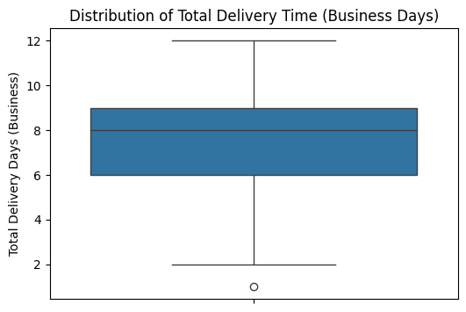
04 Total Delivery Time
Arrival_scan - Order_date
n = 333
Muesli Company claims that all the orders are normally take 7 days on average to be delivered.
Scenario 2: No duplicates, business days
Business Days Stats:
count 333.000000
mean 7.399399
std 2.050477
min 1.000000
25% 6.000000
50% 8.000000
75% 9.000000
max 12.000000
Notes:
Calendar:
count 333.000000
mean 10.834835
std 2.862257
min 3.000000
25% 9.000000
50% 11.000000
75% 13.000000
max 17.000000

Slide 21
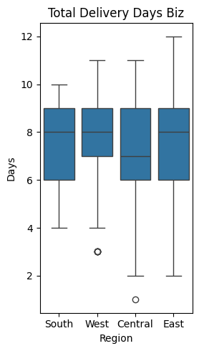
04 Total Delivery Time:
by region
Arrival_scan - Order_date
n = 333
The region (where to the order is supposed to travel) does not affect much the total delivery time.
Scenario 2: No duplicates, business days
Business Days Stats:
Central East South West
count 77 92 49 115
mean 6.9 7.34 7.63 7.68
std 2.15 2.09 1.79 2.01
min 1 2 4 3
50% 7 8 8 8
Max 11 12 10 11

Slide 22
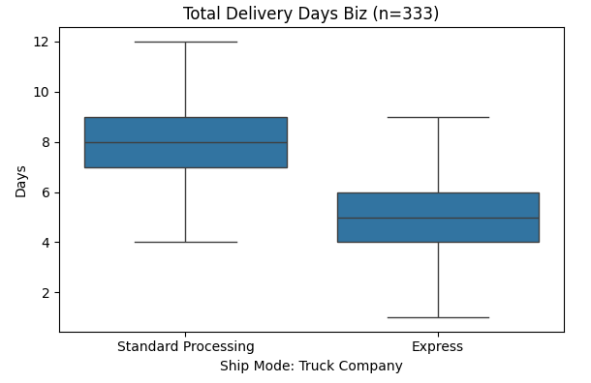
04 Total Delivery Time:
by shipment mode*
Arrival_scan - Order_date
n = 333
* Truck Company and Muesli Company use two different approaches to the shipment mode:
Muesli company has three options (First Class, Second Class, Standard Class) and Truck company has two options (Express and Standard Processing)
Scenario 2: No duplicates, business days
Business Days Stats:
Express Standard Processing
(First+Second Class)
count 75 258
mean 4.8 8.2
std 1.52 1.49
min 1 4
50% 5 8
max 9 12

Slide 23
04 KPIs summary
Stages | Company claim | Average (Scenario 1)* | Average (Scenario 2)**
Warehouse processing | ~2 days | 4.3 days | 2.8 days
Waiting for truck | 1 day | 1.8 days | ~1.36 days
Full warehouse time | 3-4 days | 6.1 days | ~4 days
Delivery | ~3 days | 4.6 days | 2.9 days
Total delivery time | 9-10 days | - | 7.4*** days
* Scenario 1 takes into account calendar days
** Scenario 2 calculates the averages based on business days
*** Total delivery time varies significantly by the shipment mode: 4.8 vs. 8.2!!

Slide 24
05 Diagnostic analytics - Where are the problems?
Express vs standard - Is express worth it?
Does day of order affect warehouse time?
Does it matter, when to place the order?
Delivery reliability - How consistent is the logistics company?

Slide 25
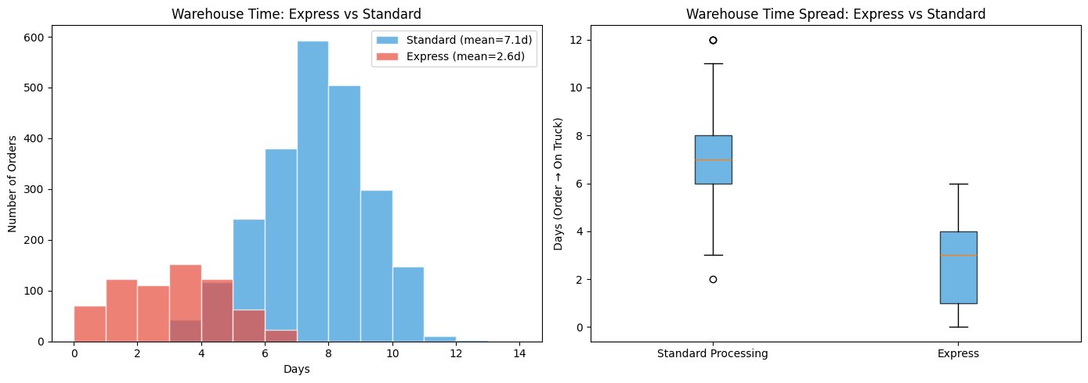
05 Diagnostic analytics - Where are the problems?
Express saves on average 4.5 days in warehouse time.

Slide 26
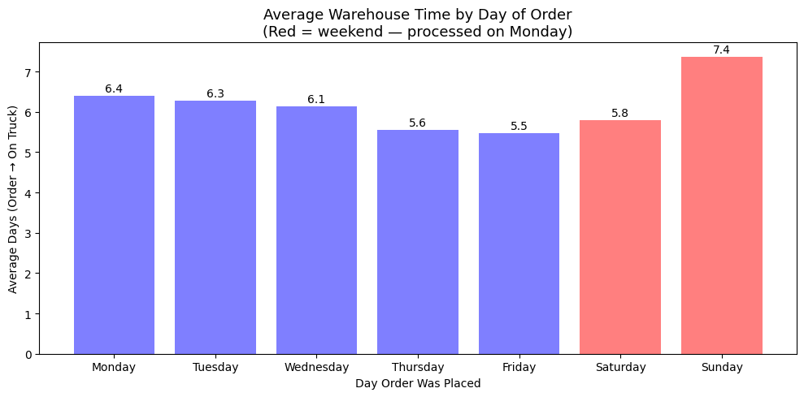
05 Diagnostic analytics - Where are the problems?
Weekend orders should take longer since the warehouse only operates Mon–Fri.

Slide 27
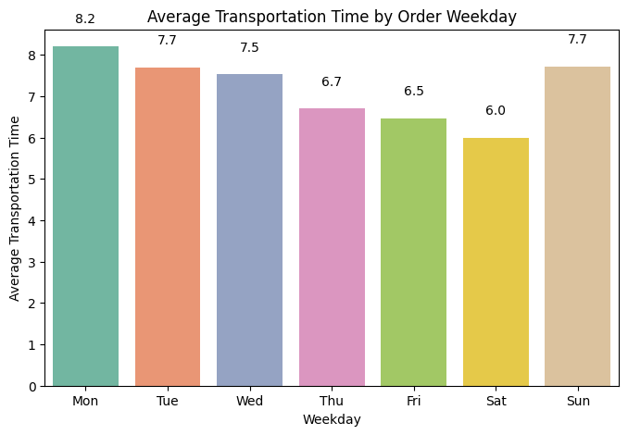
05 Diagnostic analytics - Where are the problems?
Order date vs. Total delivery
Does it matter, when a client place their order? Apparently, yes!
The graph shows how many days the delivery is going to take depending on the order day.
If you ordered a product on Monday, it will be travelling appx. for 8.2 days.

Slide 28
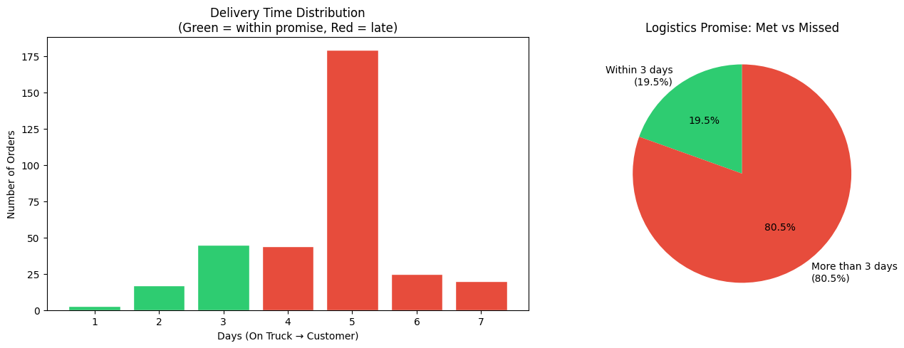
05 Diagnostic analytics - Where are the problems?
05 Diagnostic analytics - Where are the problems?
Delivery reliability - Is the logistics company consistent enough?

Slide 29
CONCLUSIONS:
Scenario 1
1/ Warehouse is the biggest bottleneck.
Processing takes more than double the claimed 2 days.
2/ Logistics company is also underperforming.
Delivery takes 4.6 days on average. Only ~21% of orders arrive within
the promised 3 days.
3/ Express processing is effective.
It reduces total warehouse time. Worth investigating,
if it could be offered more broadly.
4/ Weekend orders add delay
~15% of orders are placed on the weekends.
Naturally takes longer since the warehouse is closed.

Slide 30
CONCLUSIONS:
Scenario 2
1/ Warehouse processes too many orders on Mondays.
Only 25% of all orders are processed in 2 days or less.
2/ Overall performance of the truck company is satisfactory.
But only First Class deliveries are picked up in the promised range of time.
3/ Information about truck arrivals is inconsistent.
Both warehouse interns and truck company own scan data shows that trucks
perform pick ups on Tue and Thu.
4/ Average delivery time is about 7 days.
But the difference between shipment modes is almost doubled:
4.8 for express and 8.2 for standard delivery.

Slide 31
RECOMMENDATIONS
KPIs to track going forward…
KPI | Target
Average warehouse processing time | ≤ 2 days
% orders processed within 2 days | ≥ 80%
Average delivery time | ≤ 3 days
% orders delivered within 3 days | ≥ 80%
Express vs standard time saving | Monitor monthly

Slide 32
Thank you!
Contact our team

Slide 33
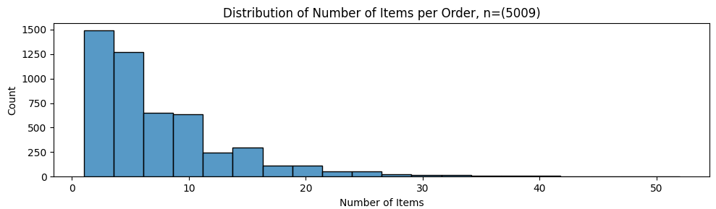
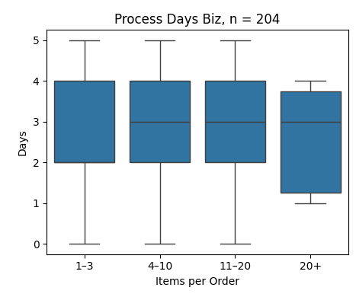
Size of an Order:
doesn't matter
There are many small orders (below 10) and very few pretty big orders (probably, just outliers), and we wanted to check if the size of the order affects the warehouse processing time.
Nope! It doesn't really.

Slide 34
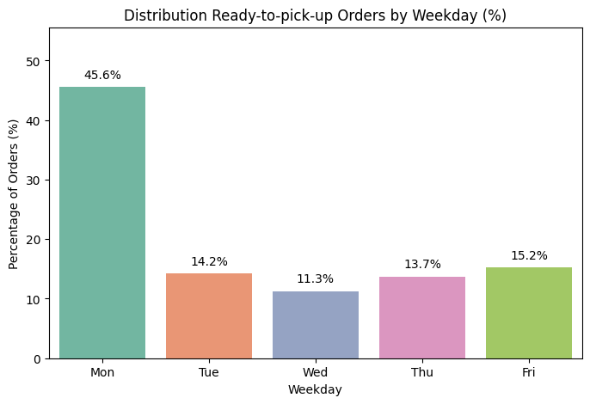
Do We Need More Truck Days?
maybe
The most orders are being picked up on Monday (45.6% of all orders).
It would be nice either to process weekend orders on Sat or Sunday
OR
Have pick ups on Tuesday as well.

